Slide 1
Introduction

Slide 2
In this lab course, we will learn…
A new language- Python3
Basic scripting in Python3
Object Oriented Programming

Slide 3
Today’s Overview
What is Python3?
Hello World
Comparing C with Python3
Installing Python3 on Windows

Slide 4
Brushing up your Programming
A program is a set of commands that execute in a particular order.
All programs contain variables which hold certain data.
Variables can hold certain type of data. For examples, integers.
A program contains operations on variables. Operations can be arithmetic, logical, etc.
Based on operations, programs have control statements like if-else.

Slide 5
Brushing up your Programming
Repeating tasks in a program are done through loops.
Using simple data types, more complex data types are created. For example, arrays, strings, unions.
User may also define other data structures like structures.
Functions can be used which perform a specific task.
User may input the data to the program too.

Slide 6
Brushing up your Programming
In C, you were also introduced to the concept of pointers which are used to store addresses of variables to manipulate them.
Strings and arrays also used pointers!
Memory Allocation could be done at runtime, called Dynamic Memory Allocation.

Slide 7
What is Python?
Most popular language in the world!
Easier to understand and code in than C or C++.
It is an interpreted language.
Program executes line-by-line. No compilation.
It is a type less language.
No need to declare variables like int x in C.
It is an indented language.
Indentation is compulsory, otherwise your program will not run!

Slide 8
What is Python?
Contains libraries and support for almost everything.
It is called a scripted language.
Runs one thing at a time.
It is an object oriented language.
Shall learn more about this later.
It’s something like Java.
No pointers in Python. All data allocated dynamically.

Slide 9
Hello World!
Let’s print the line Hello World! in python now.
After running python3, type the following command. Your cursor should be after the ‘>>>’ as of now.
>>> print (“Hello World!”)
In the terminal after this line, you should see the line printed like this:
Hello World!

Slide 10
Comparing C with Python3
Let’s compare the two hello world programs written in C and Python3.
#include <stdio.h>
int main()
{
printf(“Hello World!”);
return 0;
}
print(“Hello World!”)
C
Python3

Slide 11
Comparing C with Python3
Let’s compare the two hello world programs written in C and Python3.
#include <stdio.h>
int main()
{
int x= 2;
printf(“%d”, x);
return 0;
}
x= 2
x
C
Python3

Slide 12
Comparing C with Python3
C | Python3
C is a compiled language. After writing the code, compilation is needed to run. | Python3 or Python is an interpreted language. Python programs are run line by line.
C is typed language. Every variable needs to be declared with a type to use it. | Python3 is typeless. No need to declare a variable explicitly. Just assign it a value and use it.
In C, int type variable cannot store a float type data. | Since Python3 is typeless, a variable holding int data now can be assigned float data.
In C, indentation is not required. Blocks of codes are separated by ‘{‘ and ‘}’. | Python3 makes indentation compulsory. Blocks of code are separated by levels of indentation.

Slide 13
Installing Python3 on your Windows System
Assignments shall be given throughout the lab course. Practise coding well.
If you have a laptop, install Python3 on it.
First, go to python website: www.python.org
Click on ‘Downloads’ in the website and download Python3

Slide 14
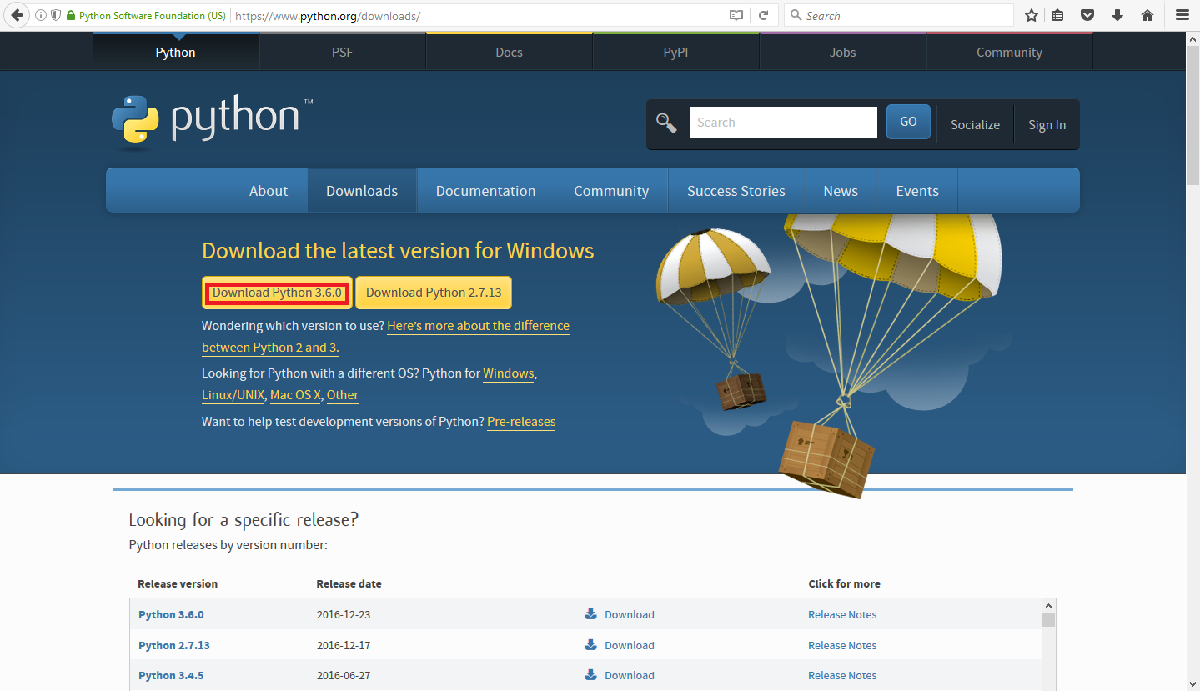
Installing Python3 on your Windows System

Slide 15
Installing Python3 on your Windows System
After the download is complete, run the exe file.
Once done, launch the program IDLE Python from Start Menu.
Start coding like you would do here in the lab!

Slide 16
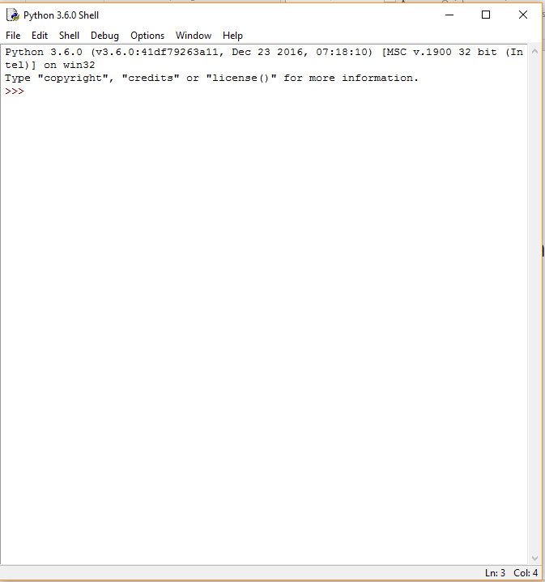
Installing Python3 on your Windows System

Slide 17
Summary
We recounted our programming experience in C from previous lab.
A brief introduction to what Python is and what are it’s features.
Launching Python3 in Linux Terminal.
First program in Python3.
We compared C and Python3 based on what we coded.
We saw how to install Python3 on Windows (it’s really simple, don’t forget to try!)

Slide 18
Thank you for your patience

